Slide 1
Lecture Zero MTH 401 : Discrete Mathematics
Teacher’s Name: Mr. Pardeep Kumar
Department of Mathematics
Lovely Professional University
Phagwara, Punjab

Slide 2
Contents
Course Details
Course Objectives
Text / Reference Books
Course Assessment Model
Course Contents
Learning Outcomes

Slide 3
Course Details
Course Credits
L-T-P : 3-0-0

Slide 4
Course Objectives
Through this course students should be able to
understand various ways to prove or disapprove some logical statements.
solve recurrence relation by using different methods.
describe the concept of graphs and their properties.
give essential knowledge of discrete mathematics to students.
understand various concepts of number theory and its applications.

Slide 5
Books
Text Book
DISCRETE MATHEMATICS AND ITS APPLICATIONS (SIE) by KENNETH H. ROSEN, MCGRAW HILL EDUCATION, 7th Edition, (2011)
Reference Books
1. HIGHER ENGINEERING MATHEMATICS by B. V. RAMANA, MC GRAW HILL , 10th Edition, (2007)

Slide 6
Course Assessment Model
Components | Marks | Weightage out of 100
Attendance | 5 Marks | 5 Marks
CA (Best two out of three tests) | 30 Marks each | 25 Marks
MTE | 40 Marks | 20 Marks
ETE | 70 Marks | 50 Marks
Note: One CA can be waived off if student register for the respective MOOCs

Slide 7
MOOCs details
This course is mapped with MOOCs "noc19-cs49 Discrete Mathematics by NPTEL)
Course Id | Discipline | Course Name | Duration | Course Start Date | Course End Date | Exam date | Link to join | Fee
noc19-cs49 | Computer Science and Engineering | Discrete Mathematics (IITG) | 12 Weeks |  |  |  | https://swayam.gov.in/nd1_noc19_cs49/ | Rs 1000/
If a student registers for this course and clear it then one academic task can be waived off depending upon the result.
Example : if a student get 50% marks in MOOCs exam then he will be awarded 50% marks for one academic task
If the student appears in both academic task and MOOC then best of the two will be considered

Slide 8
Course Contents
Logic and Proofs
Recurrence relations with constant coefficients
Counting principles and relations
Graphs
Tree graphs, Applications of trees, Tree traversal
Number theory and its application in cryptography

Slide 9
Learning Outcomes
On successful completion of the course, the students should be able to:
learn the recurrence relation, Solution of a recurrence relation, Homogeneous linear recurrence relation with constant coefficients.
understand Relations and their properties, Equivalence relations, Partial ordering relations, Lattice, Sub lattice.
understand graph terminology and special types of graph then explore it in the graph isomorphism, shortest path problem and connectivity.
apply the divisibility, greatest common divisor and congruence in Cryptography.
describe various ways to prove or disapprove some logical statements.

Slide 10
Why Discrete Math Is Important
Discrete math is the mathematics of computing.
Discrete math is very much "real world" mathematics.
Discrete math teaches mathematical reasoning and proof techniques.
Discrete math is fun.

Slide 11
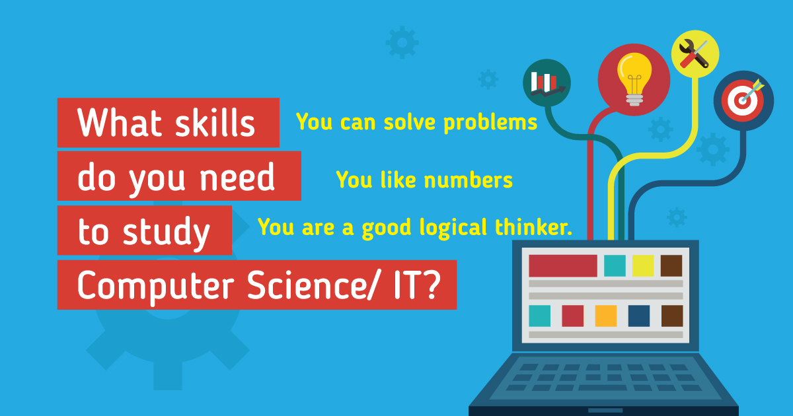
Why to study logics and Proof ?
Computer programs are written in special, symbolic languages, e.g., Fortran, C++, Lisp, Prolog. These languages contain features of logical symbolism, and Lisp and Prolog are derived from formal languages for logic. Through such connections, the study of logic can help one in the design of programs.

Slide 12
APPLICATIONS OF recurrence relation AND GRAPH THEORY…?

Slide 13
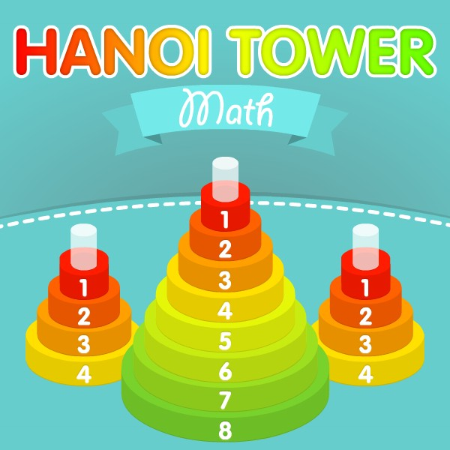
Solution of tower of Hanoi game for n disk?

Slide 14
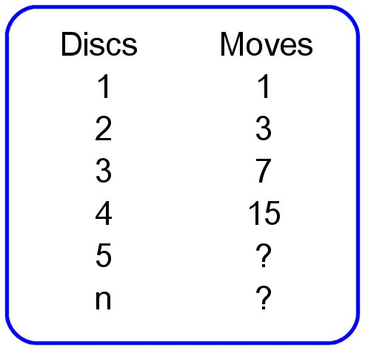
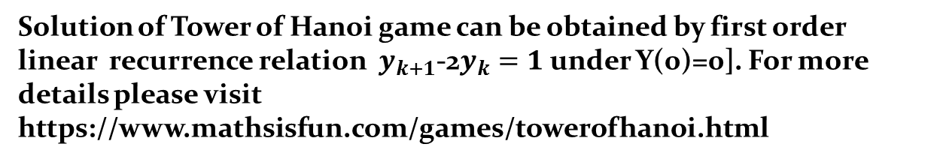
Solution of Tower of Hanoi game can be obtained by first order linear recurrence relation $y_{k+1}$-2$y_{k}=1$ under Y(0)=0]. For more details please visit https://www.mathsisfun.com/games/towerofhanoi.html

Slide 15
Application of graph theory
Consider the problem of joining three houses to each of three separate utilities, as shown in
Figure . Is it possible to join these houses and utilities so that none of the connections cross?
In this section we will study the question of whether a graph can be drawn in the plane
without edges crossing. In particular, we will answer the houses-and-utilities problem.

Slide 16
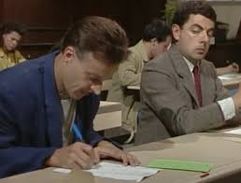
Assignment problem
There are 50 students in the class and teacher needs to prepare minimum number of class test for them in a way such that no two consecutive students get the same assignment.
It can be done via graph coloring , teacher can find chromatic no. of graphical representation of students

Slide 17
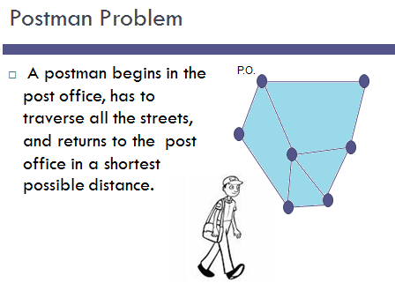

Slide 18
Determining if two compounds with the same formula are identical.
H
O
N
H
H
O
N
C
H
H
H
C
C
C
H
H
C
N
H
H
N
N
H
C
N
O
H
C3H7N2O2
H
H
O
Graph isomorphism problem

Slide 19
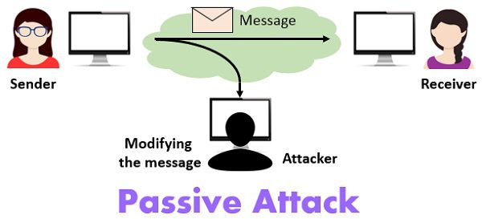

Cryptography

Slide 20
Thank You

